Slide 1
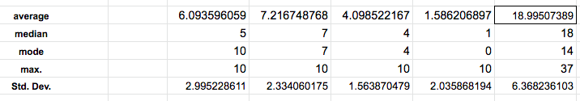

Midterm statistics
Expected grades:

Slide 2
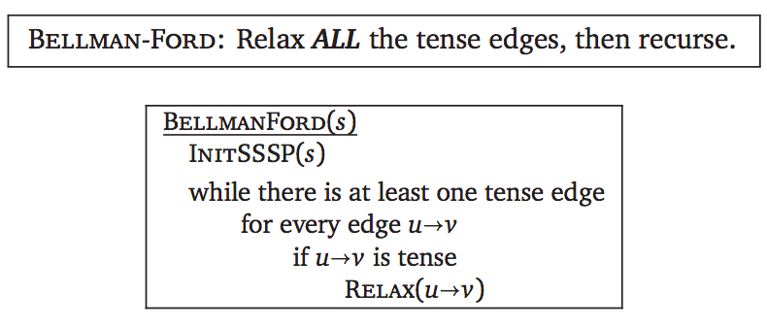
Bellman-Ford: Graphs with negative edges

Slide 3
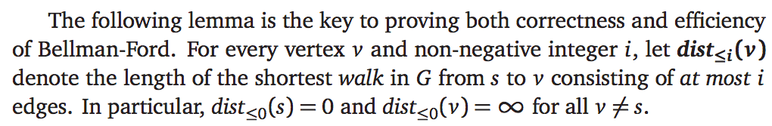
Bellman-Ford: Correctness Proof

Slide 4
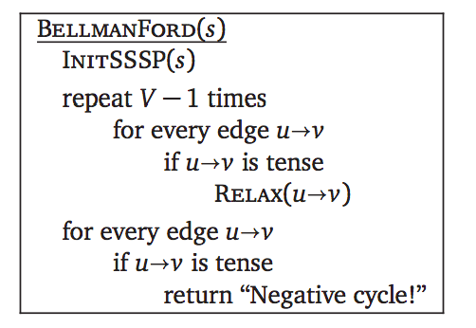
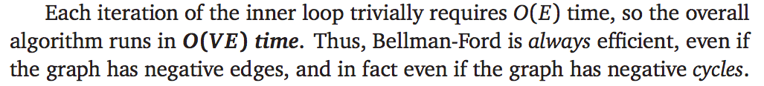
Bellman-Ford: Find negative cycles

Slide 5
Bellman-Ford: Find negative cycles

Slide 6
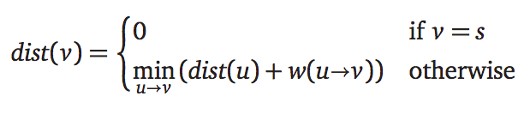
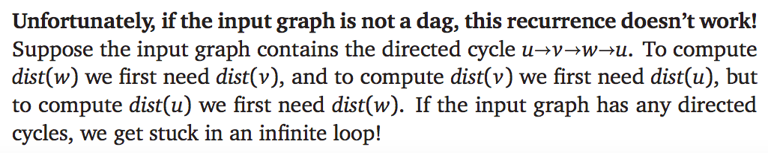
Bellman-Ford: Dynamic Programming
It’s tempting to use the same identity that we exploited for directed acyclic graphs:

Slide 7
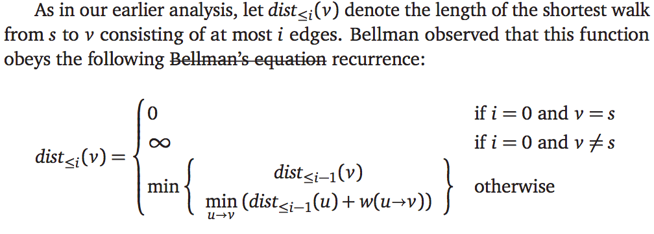
Bellman-Ford: Dynamic Programming
Correctness of the final shortest-path distances follows from the correctness of the recurrence, and the O(V E) running time is obvious.

Slide 8
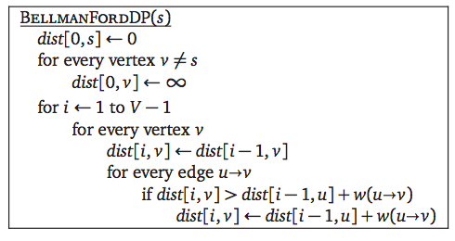
Bellman-Ford: Dynamic Programming

Slide 9

Chapter 9
All-pair shortest paths
Divesh Aggarwal
School of Computing
Department of Computer Science

Slide 10
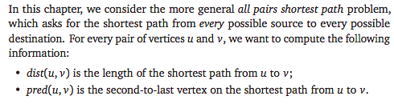
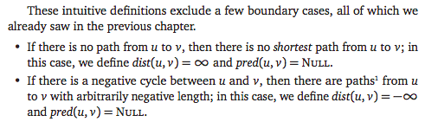
All-pair shortest paths

Slide 11



The obvious algorithm

Slide 12

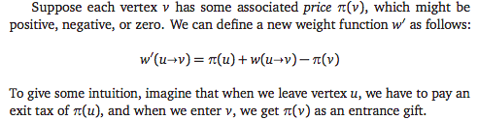
Reweighting
Increasing all edge weights by a constant doesn’t work!

Slide 13

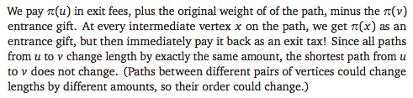
Reweighting

Slide 14
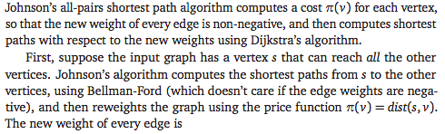

Choosing the price function

Slide 15
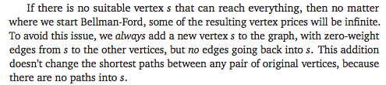
Choosing the source vertex s

Slide 16
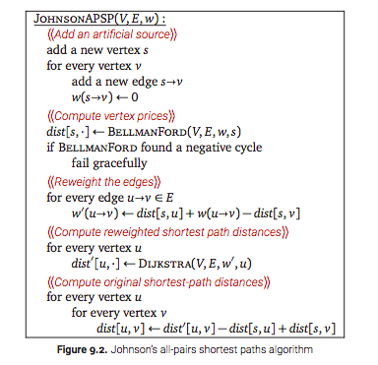
The algorithm

Slide 17

Complexity analysis

Slide 18
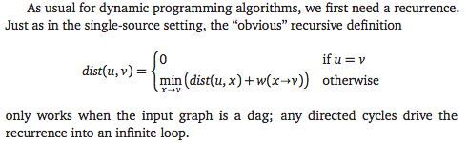
Dynamic programming algorithm

Slide 19
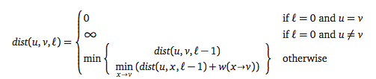
Just as in Bellman-Ford…
Let dist(u,v,i) be the shortest path from u to v with at most i edges

Slide 20
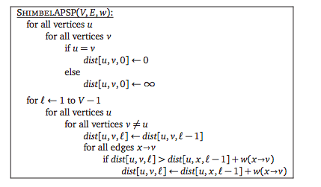
The algorithm

Slide 21



Divide and conquer

Slide 22
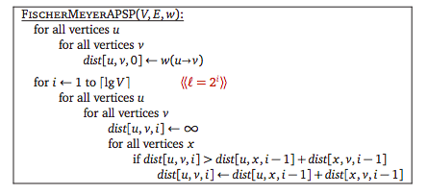
Divide and conquer algorithm

Slide 23
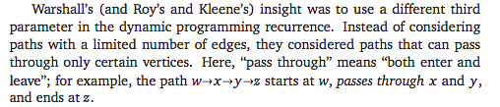

Floyd-Warshall algorithm

Slide 24
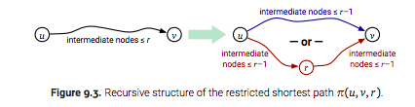

Recurrence relation

Slide 25

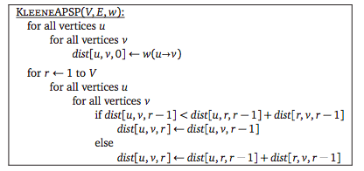
The Algorithm

Slide 26
Lower bounds
Divesh Aggarwal
School of Computing
Department of Computer Science

Slide 27
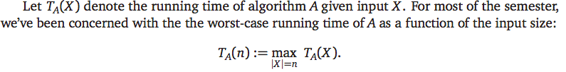

What is a lower bound?

Slide 28
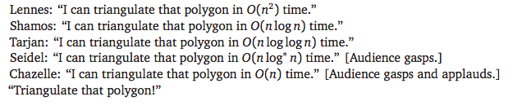
Upper bounds vs lower bounds
Algorithms research is often about statements like…

Slide 29
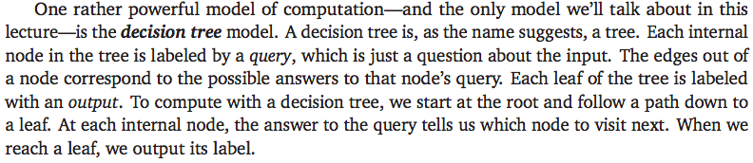
Decision tree model

Slide 30
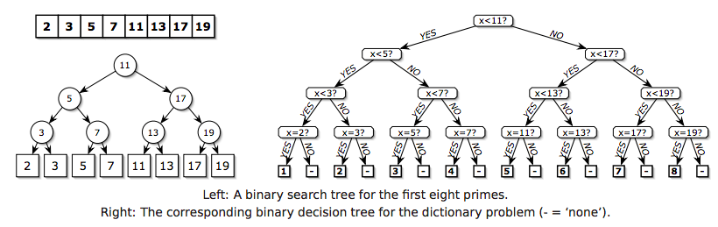
Decision tree for the dictionary problem..
Here’s another simple and familiar example, called the dictionary problem. Let A be a fixed sorted array with n numbers. Suppose we want to determine, given a number x, the position of x in the array A, if any.

Slide 31
Decision tree for the dictionary problem..
Here’s another simple and familiar example, called the dictionary problem. Let A be a fixed sorted array with n numbers. Suppose we want to determine, given a number x, the position of x in the array A, if any.

Slide 32
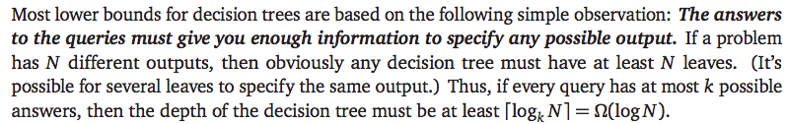

Decision tree for the dictionary problem..

Slide 33

The model is crucial..
No, it isn’t. The reason is that hashing involves a query with more than a constant number of outcomes, specifically ‘What is the hash value of x?’

Slide 34
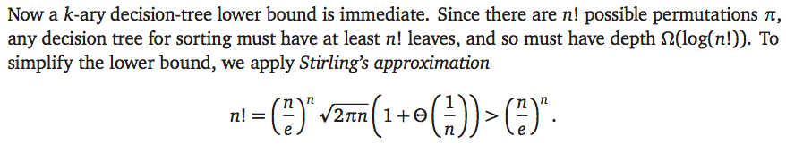
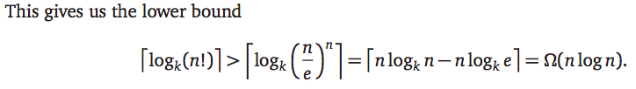
Sorting lower bound in the decision tree model

Slide 35
Sorting lower bound in the decision tree model

Slide 36
Finding the maximum
The information-theoretic method gives a lower bound of log n. This bound is tight. Why?
We can locate the maximum element by asking only log n ‘unreasonable’ questions like “Is the index of the maximum element odd?”
We need to consider a more reasonable model of computation, by restricting the kinds of questions the algorithm is allowed to ask. We will consider the comparison tree model, where every query must have the form “Is xi > x j?”.

Slide 37
Finding the maximum
The information-theoretic method gives a lower bound of log n. This bound is tight. Why?
We can locate the maximum element by asking only log n ‘unreasonable’ questions like “Is the index of the maximum element odd?”
We need to consider a more reasonable model of computation, by restricting the kinds of questions the algorithm is allowed to ask. We will consider the comparison tree model, where every query must have the form “Is xi > x j?”.

Slide 38
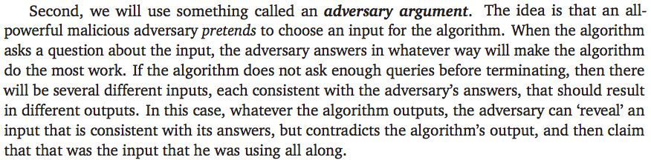
We will use the adversary argument
For the maximum problem, whenever the adversary reveals that x_{i} < x_{j} , he marks x_{i} as an item that the algorithm knows (or should know) is not the maximum element. If there are less than t comparisons, then the algorithm knows that t elements are not maximum. Any other element can be the maximum.
Thus, the algorithm is correct on all inputs if and only if t is at least n-1.

Slide 39
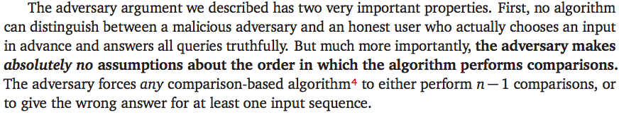
The adversary argument
You might want to look at the adversary arguments chapter from Jeff Erickson’s notes for other examples.

